Slide 1
Managing Stepwise Process for Improving the Quality of HIV Rapid Testing and Recency eTools for PT – SPIRRT
Laboratory Data Monitoring Team
International Branch, CDC Atlanta
RTCQI Best Practices Workshop-Africa Region

Slide 2
Agenda
Overview of SPI-RRT Data Management
Roles and Responsibilities of Stakeholders
Data Flow and Management Overview
Live Demonstration of the Data Tool

Slide 3
Overview
The SPI-RRT checklist has been instrumental in setting minimum standards across all HIV RT/RTRI testing points, guiding facilities toward continuous quality improvement. By employing the checklist, facilities have been able to identify quality gaps and areas needing enhancement to meet national quality standards.
eTool for SPI-RRT helps:
  Transform: Transforms the checklist from a paper-based to a tablet-based system, simplifying data collection and enabling real-time insights through an interactive dashboard.
  Assist: Assists the quality manager in planning and managing site inspection, enhancing resource allocation, and reviewing audit results via the dashboard.
  Highlight: Highlight specific areas where improvements are necessary, allowing facilities to focus on these areas for better compliance and performance.

Slide 4
Stakeholders and Their Roles
Quality Manager:
  Primarily responsible for managing the audit process and assisting in stepwise improvement. This includes selecting the site’s inspection calendar, reviewing inspection results, and working with the site to improve.
Auditors:
  Visit the site to review the current state of RT/RRT testing.
  Collect data using the tablet-based survey tool.
  Compile and sync data for the dashboard via the tablet.
Laboratories:
  Participate in the site inspection process.
  Work on received feedback to improve

Slide 5
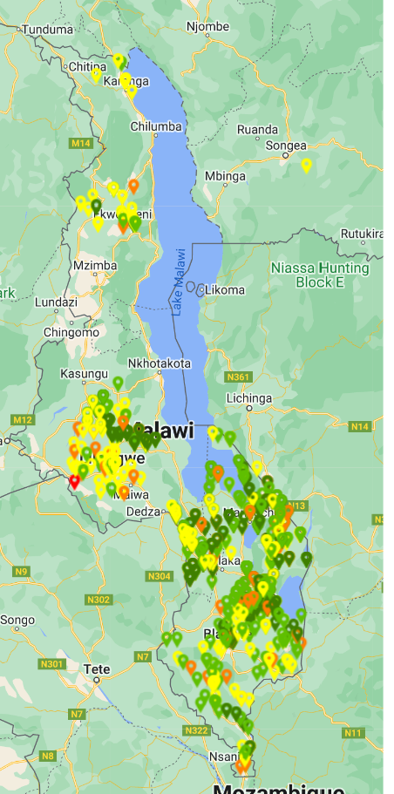
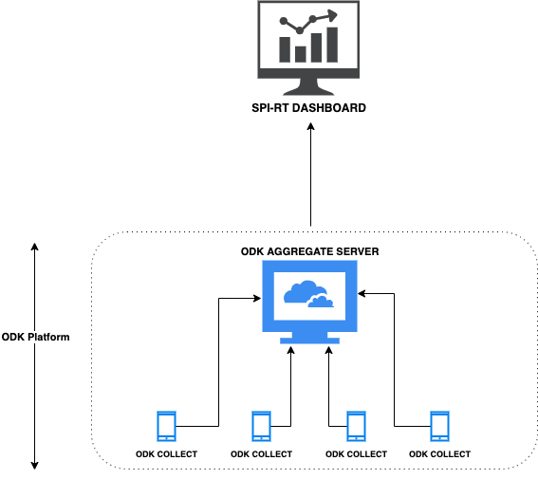
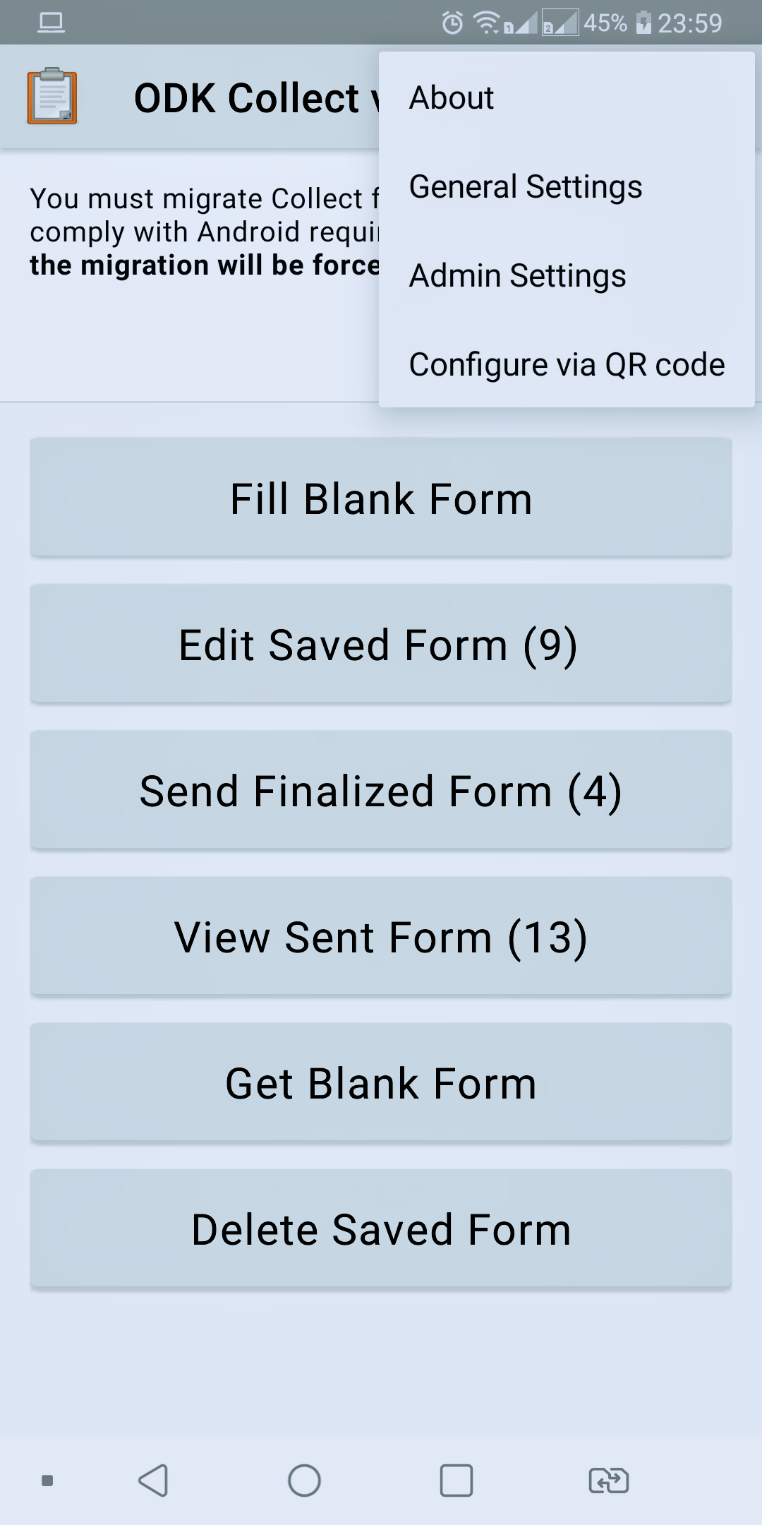
Data Flow and Management
Flowchart Description:
zaq@12345

Slide 6
AFENET DEMO

Slide 7
Question and Discussion

Slide 8
Thank You

